Slide 1

BDM Capstone Project
Project Title- Statistical DATA analysis for Solar Panel Distribution in a Tier 3 city
Presented by-
Kanika Maheshwari
22ds1000263

Slide 2
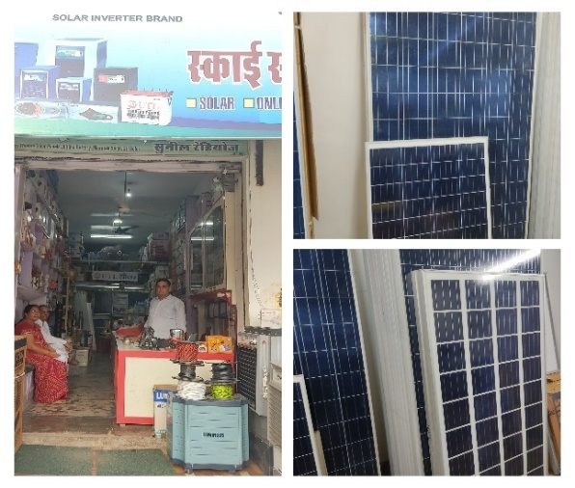
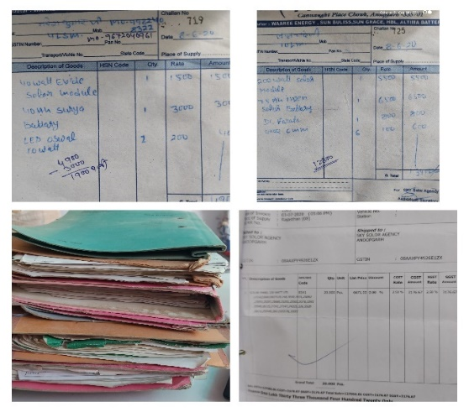
Introduction
Sky Solar Agency is a B2C, Anupgarh (Rajasthan) based firm dealing with solar panels, inverters and its components.
With shift of Conventional sources to Renewable energy sources, firm has great opportunity in the market and a significant contribution towards Greener planet.
Firm was dealing with solar panel orders according to the customer’s requirements (whenever needed) without any inventory management. Recently, the firm has invested in an inventory.
Mr. Sunil Yogi, Shop owner, wanted to plan their newly established inventory based on the performance of sales for past four financial years.
Collecting the data was a big challenge because all the data was unorganised and scattered.
We have done the revenue and volume analysis over the years.
Analysis was done on Yearly, Monthly and Quarterly sales. In addition to, the items generating high revenue and high volumes were tracked down using Pareto principle and Tree map.
The correlation between Sales and Watt powers has also witnessed.

Slide 3
Revenue and VolumeAnalysis

Slide 4
Quarterly and Monthly Revenue Analysis

Slide 5
Volume of Sales (Year wise)
Brand Names | Watt Powers (W) | SKU Name
Waaree | 445 | W_01
Waaree | 335 | W_02
Waaree | 330 | W_03
Waaree | 300 | W_04
Waaree | 100 | W_05
Waaree | 75 | W_06
Waaree | 50 | W_07
Waaree | 40 | W_08
UTL | 335 | U_01
UTL | 330 | U_02
UTL | 320 | U_03
UTL | 300 | U_04
UTL | 100 | U_05
UTL | 50 | U_06
UTL | 40 | U_07
UTL | 25 | U_08
UTL | 15 | U_09
Adani | 460 | A_01
Adani | 335 | A_02
Adani | 330 | A_03
Adani | 325 | A_04
Adani | 320 | A_05
Adani | 220 | A_06
Adani | 200 | A_07
Adani | 160 | A_08
Adani | 100 | A_09
Adani | 75 | A_10
Adani | 50 | A_11
Adani | 40 | A_12
Reil | 450 | R_01
Reil | 250 | R_02
Reil | 150 | R_03
Reil | 125 | R_04
Reil | 40 | R_05
Reil | 20 | R_06
Reil | 15 | R_07
Okaya | 335 | O_01
Okaya | 320 | O_02
Okaya | 150 | O_03
Okaya | 50 | O_04
Microtek | 320 | M_01
Microtek | 100 | M_02
Microtek | 50 | M_03
Luminous | 335 | L_01
Luminous | 330 | L_02
Luminous | 270 | L_03
Luminous | 160 | L_04
Luminous | 100 | L_05
Luminous | 40 | L_06

Slide 6
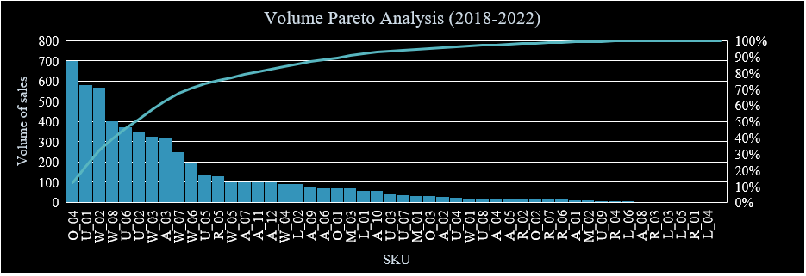
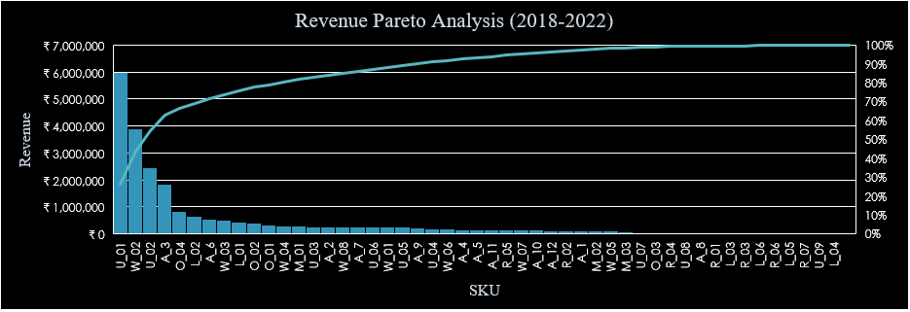
Pareto Analysis

Slide 7
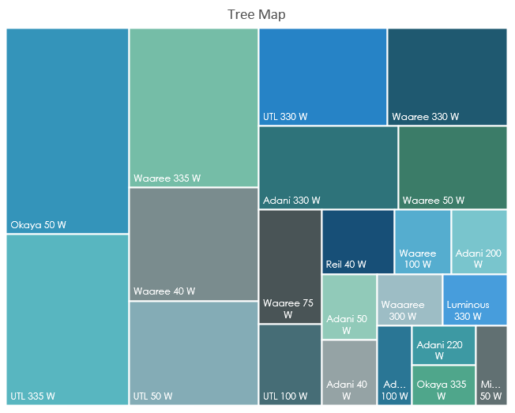
Correlation between Sales and Watt power
Tree map

Slide 8
Observations
Overall growth of the firm is steady. The COVID-19 hit the business very little and subsequent years yielded very good revenue and sales.
The firm used to purchase solar panels according to the customer’s orders, which resulted in the high transportation costs over the years.
From the data analysis of four fiscal years, we have perceived that UTL-335W, Waaree-335W, Adani-330W, UTL-330W, Luminous-335W, Luminous-330W, Waaree-330W are highest revenue generating SKUs.
The highest volume generating SKUs are Okaya-50W, UTL-335W, Waaree-335W, UTL-50W, UTL-330W, Waaree-40W, Waaree-50W, Waaree-75W, Adani-330W.
The revenue has increased significantly over the years from 2018-19 to 2021-22.
The volume of sales increased over the years from 2019-20 to 2021-22 except a small decrement from 2018-19 to 2019-20, which was due to COVID-19.
The lowest sales were in Q2 and Q3 of 2019-20 due to crop failure in the region.
There is no clear symmetric trend of sales over the years, but there are high sales in June, July, September, October, January, February months, which significantly shows the effect of agriculture seasons on the sales.
Potential buyers are Households, Small offices, and Agriculture land owners.
There is a positive correlation between sales and watt power of solar modules. The 335W and 330W solar panels are most revenue generating and most selling SKUs. The 40W and 50W SKUs are generating high volumes, but less revenues. Whereas 100W, 200W and 300W are less selling and less revenue generating SKUs overall.
The major SKUs in demand are 40W -335W solar modules, sufficient to supply small to medium requirements of the city daily.

Slide 9
Recommendations
The firm should invest in solar modules ranging from 40W-335W watt powers.
The firm should keep the stocks of UTL-335W, Waaree-335W, Adani-330W, UTL-330W, Luminous-335W, Luminous-330W, Waaree-330W, Okaya-50W, UTL-50W, Waaree-40W, Waaree-50W, Waaree-75W specifically.
The firm should keep their stocks full specially in the months of January, April, June, July, September, and October.
The firm can plan to purchase solar modules on fix time intervals now, so that the transportation costs can be optimized.
Cleaning the solar modules time to time is very essential for getting the high efficiency output. To promote their sales and goodwill among the customers, the firm can plan to give cleaning services for the solar modules twice a year for the first year of purchase. As it will give an edge benefit to their sales and it will increase awareness about the importance of cleaning the solar panels in the customers too.
The firm can invest in a computer or software to keep their purchase and sales data organized and structured.

Slide 10


